Slide 1
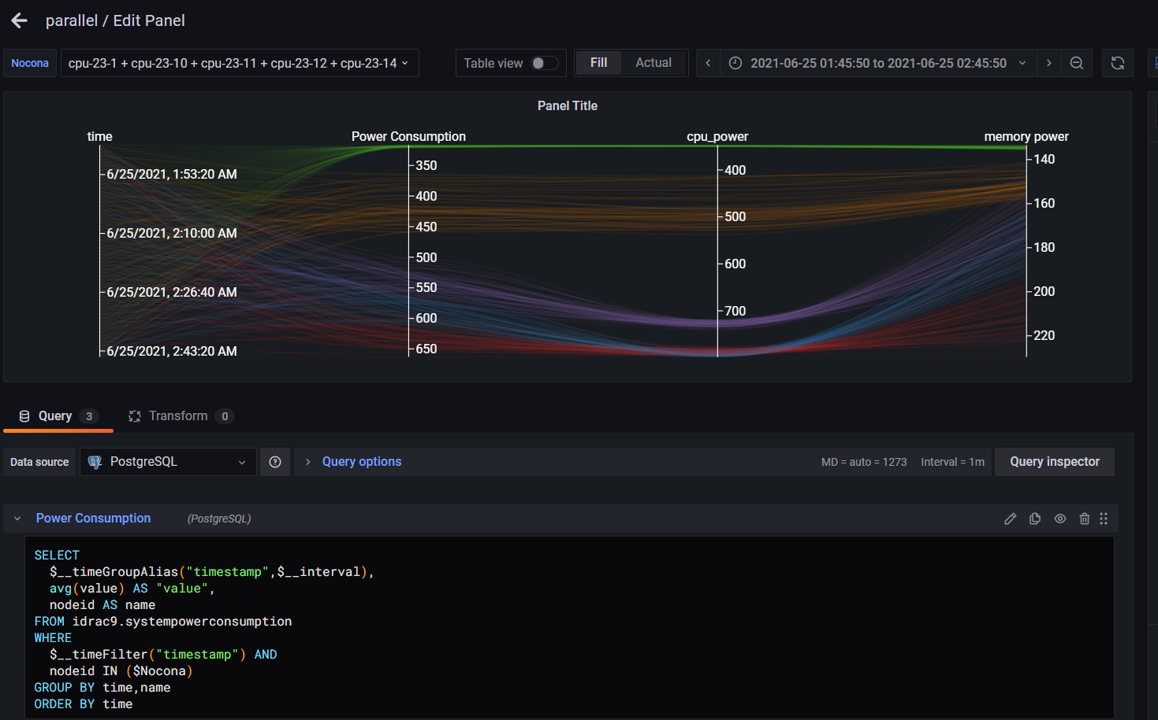
Grafana Plugin
Weekly report

Slide 2
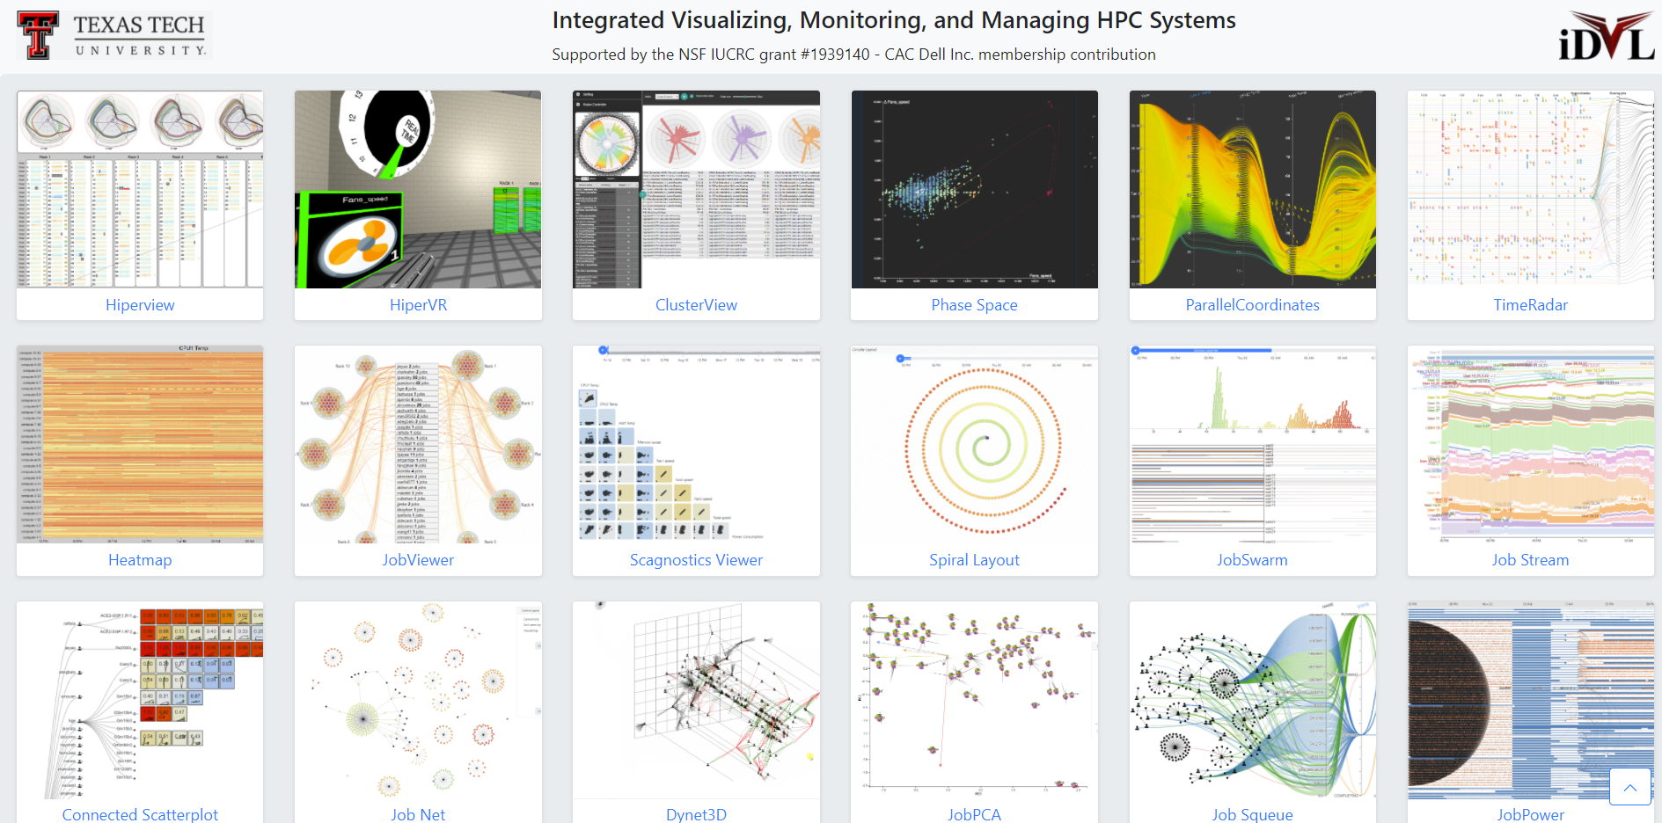
Overview

Slide 3
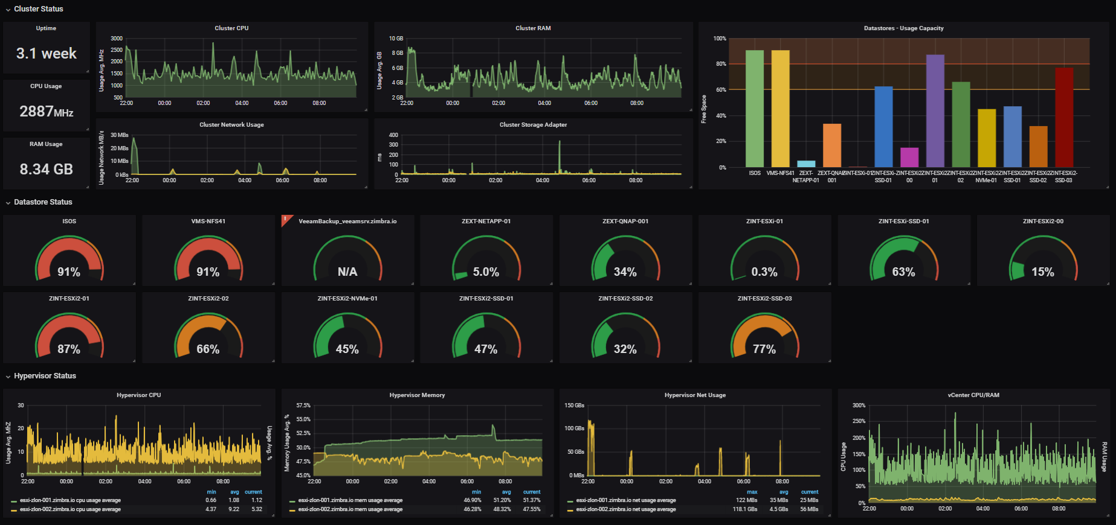
Overview
Design for specific tasks
Specific schema depend on Monster API
Friendly data query
Open-source
Well-known

Slide 4
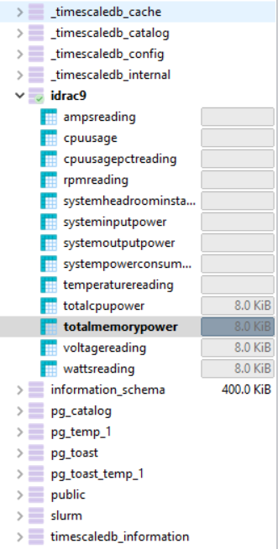
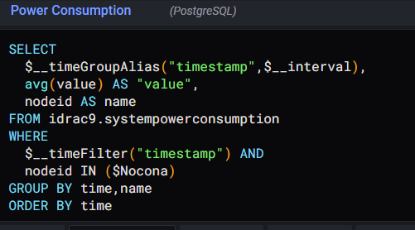
Current set-up
Connect to redraider database through VPN and port-forwarding
Using custom query for PostgreSQL
Develop panel plug-in with React (Typescript)

Slide 5
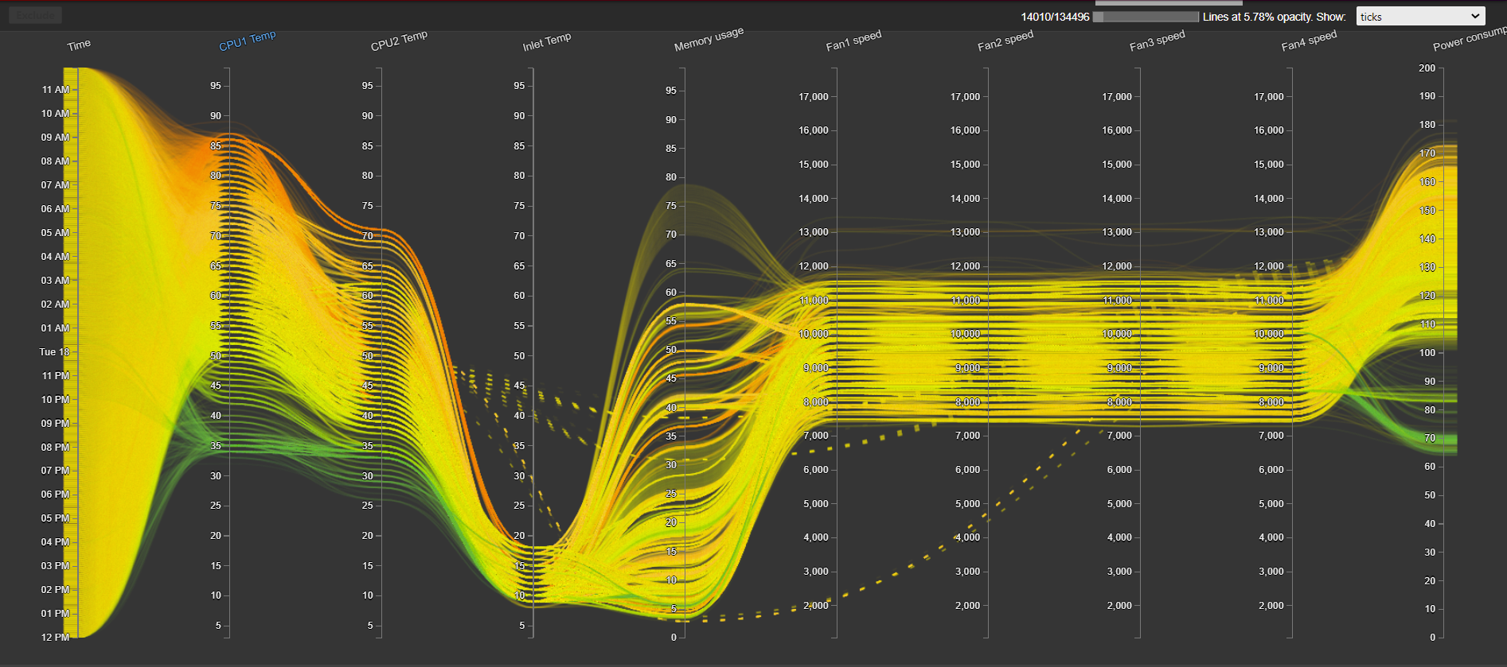
Ordinal visualization
https://idatavisualizationlab.github.io/HPCC/ParallelCoordinates/index.html

Slide 6
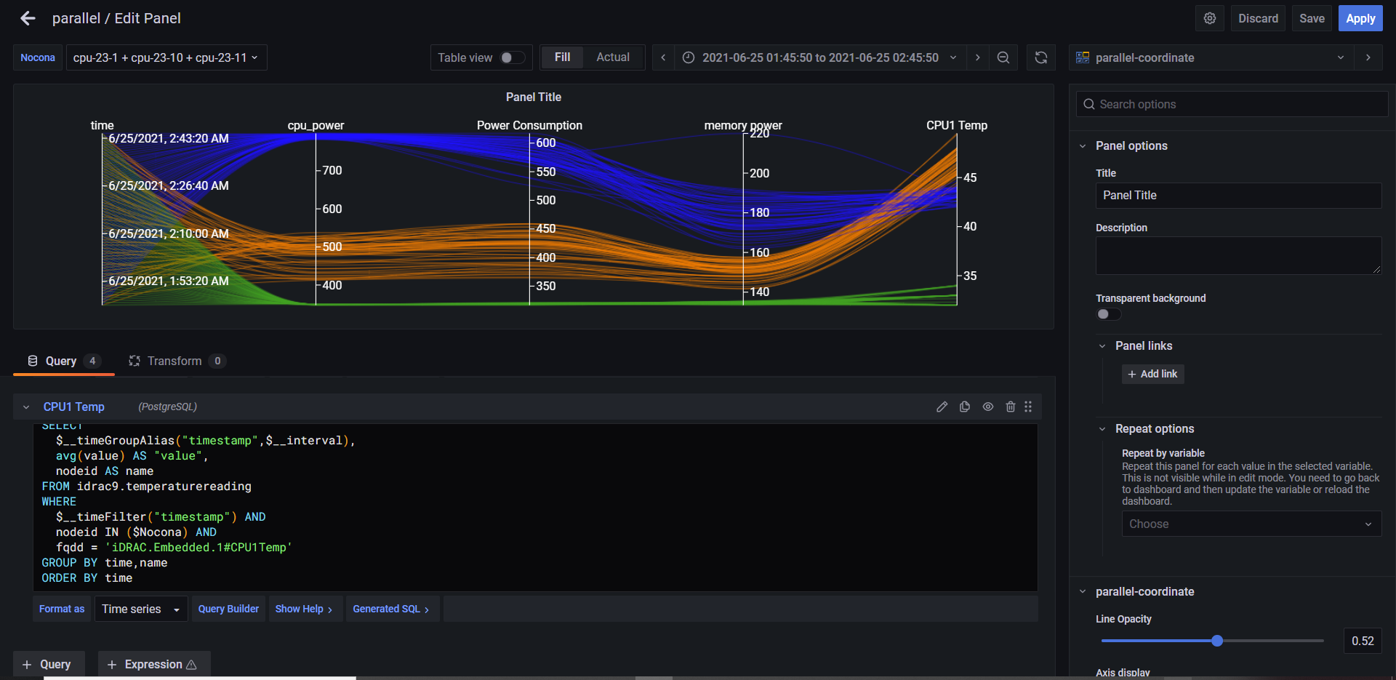
Current result
Primary app: https://idatavisualizationlab.github.io/HPCC/ParallelCoordinates/index.html

Slide 7
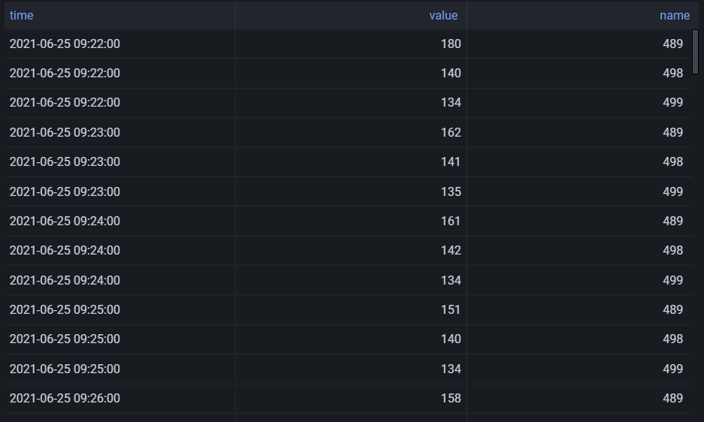
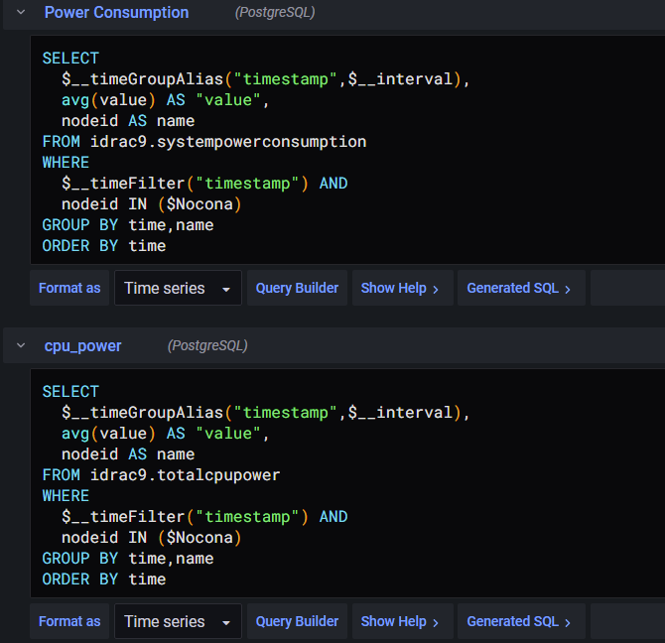
Current result
Each axis is single query
Axis name is the query’s name
Required fields: time, value, name (nodeid)
General structure:
Table name

Slide 8
Current result
Each axis is single query
Axis name is the query’s name
Required fields: time, value, name
General structure:
Table name

Slide 9
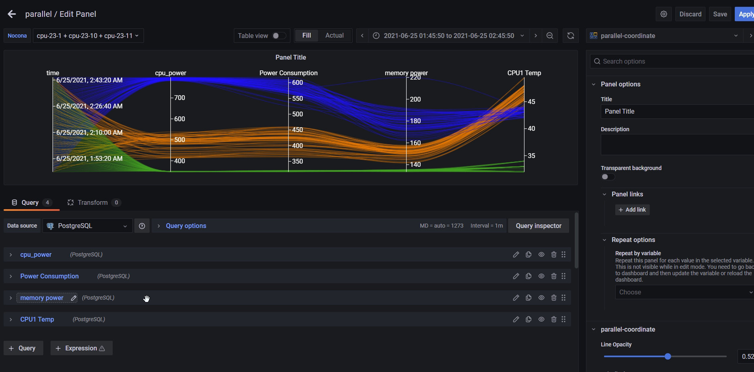
Current result

Slide 10
Future features
Color by Metrics (current color by compute)
Violin summary on each axis
Rendering by sequences
Show node information when filter

Slide 11
Challengs
I have trouble with using SQL query ( it should be a better way to query multi metrics and multi-node than my current schema)
Job data isn’t available to query
Grafana have many direction to go and features to discovery (transform data, repeat on panel and link between panels)

Slide 12
Concern
Do we need full metric’s describe table with min-max for each metrics?

